Slide 1
Digitalizing Agricultural procurement (apmc mandi’s)
AIM OF THE PROJECT…….

Slide 2
Current working of the apmc’s
1.Farmer enters the apmc
2. Goes to the middlemen (dalal).
3. group of vendors arrive there along with the gov agent.
4.the vendors manually examine the produce and decide the bidding amount.
5.the bid takes place among the vendors and the highest bidder gets the produce .
6. the middle men takes his commission and the commission of the labour etc and then passes the remaining amount to the farmer.

Slide 3
Drawbacks of the current working system .
1.the distance is a big factor
2.the commission given to the middle men reduces the farmers income
3.the vendors can lobby and decide on a fixed lower price as they know that the poor farmer has travelled miles with his produce and has no means to carry it back again.
Thus depriving the farmers of fair prices .
4.the vendors can delay the payment to the farmers .

Slide 4
What we propose….
1.digitalizing the procurement by creating a common All India online portal for the farmers the vendors and the administration .
2. conducting E-Auctions.
3. Avoiding the middle-men
4. the farmers can have flexible market right at the click of a button
5.A farmer in one state can sell his produce anywhere in India like wise a vendor can buy any where in India.

Slide 5
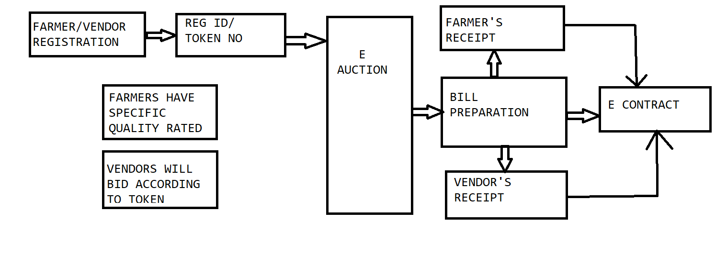

Slide 6
create table Farmer
(
FarmerID CHAR(10) primary key,
FullNAME VARCHAR(40),
Contact bigint,
Gender CHAR(10),
APMC CHAR(20),
State CHAR(20),
BankName CHAR(50),
AccountNumber bigint,
LicenceNumber bigint,
District CHAR(20),
Tehsil CHAR(20),
PinCode int,
EmailID VARCHAR(20),
Address text,
DOB date,
AuctionDate date,
);
create table Vendor
(
VendorID CHAR(10) primary key,
FullNAME VARCHAR(40),
Contact bigint,
Gender CHAR(10),
APMC CHAR(20),
State CHAR(20),
BankName CHAR(50),
AccountNumber bigint,
LicenceNumber bigint,
District CHAR(20),
Tehsil CHAR(20),
PinCode int,
EmailID VARCHAR(20),
Address text,
DOB date,
);

Slide 7
create table Products
(
ProductID CHAR(10) primary key,
ProductName CHAR(20),
FarmerID CHAR(10),
CategoryID CHAR(10),
Quantity CHAR(15),
Price CHAR(10),
QualityID VARCHAR(10),
constraint fk_Cat_ID foreign key(CategoryID) references category(CategoryID),
constraint fk_farm_ID foreign key(FarmerID) references farmer(FarmerID)
);
create table category
(
CategoryID CHAR(10) primary key,
Cat_Type VARCHAR(10),
Cat_SubType VARCHAR(10)
);

Slide 8
create table Orders
(
OrderID CHAR(10) primary key,
ODate date,
FarmerID CHAR(10),
VendorID CHAR(10),
ProductID CHAR(10),
BasePrice double,
SellingPrice double,
PaymentStatus VARCHAR(20),
constraint fk_farm_Ord_ID foreign key(FarmerID) references farmer(FarmerID),
constraint fk_vend_Ord_ID foreign key(VendorID) references vendor(VendorID),
constraint fk_prod_Ord_ID foreign key(ProductID) references products(ProductID)
);
create table Auction
(
AuctionID CHAR(10),
FarmerID CHAR(10),
ProductID CHAR(10),
VendorID CHAR(10),
BidAmount double,
Quantity int,
AuctionDate DATE,
);
create table Counter
(
Ctr_name CHAR(10) primary key,
Ctr_Value int,
);

